Slide 1
Breaking the glass: Best practices for enabling emergency access to your tenant
Alexander Solaat Rødland & Marius Solbakken Mellum
Amesto Fortytwo & Amesto Fortytwo
Notes:
En engelskmann, franskmann og tysker kommer inn på zachen….

Slide 2

Alexander Solaat Rødland
Amesto Fortytwo
Geek for more than 20 years
Microsoft MVP Windows and Devices
Windows Insider MVP
“It’s easier to stay out, than get out”

Slide 3

Marius Solbakken Mellum
Amesto Fortytwo
15 years in Microsoft identity
Microsoft MVP @ Security

Slide 4
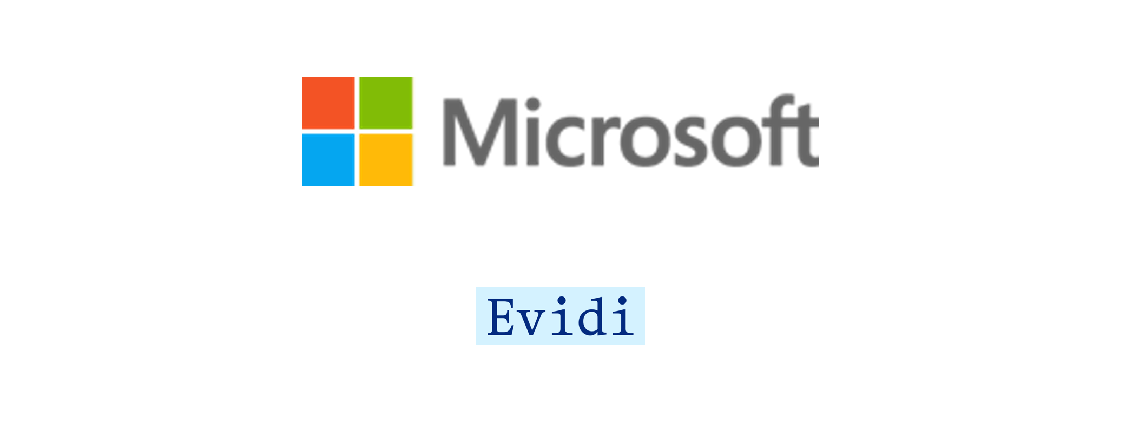

Slide 7

Once upon a time
An organization wanted to block signins from China
They added a conditional access policy for blocking

Slide 8
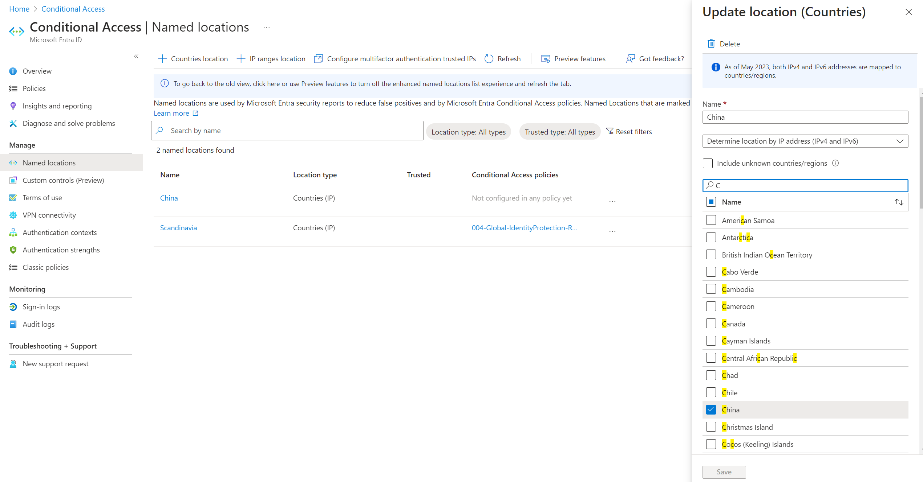

Slide 9
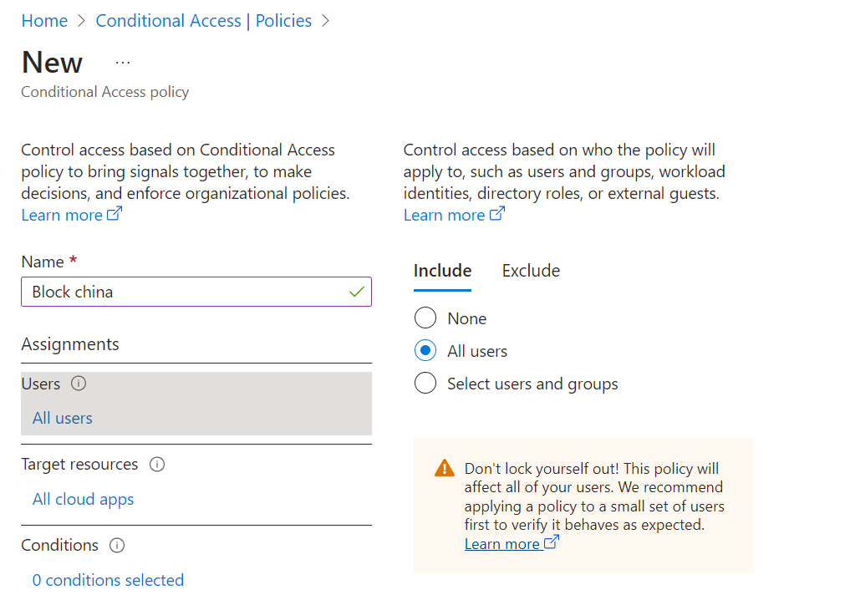

Slide 10
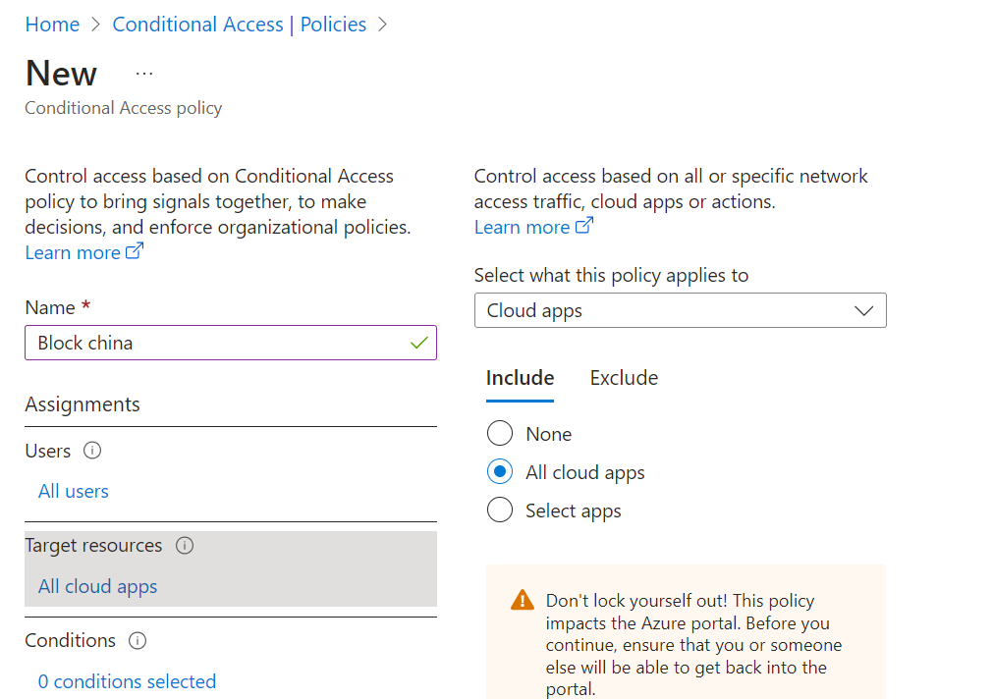

Slide 11
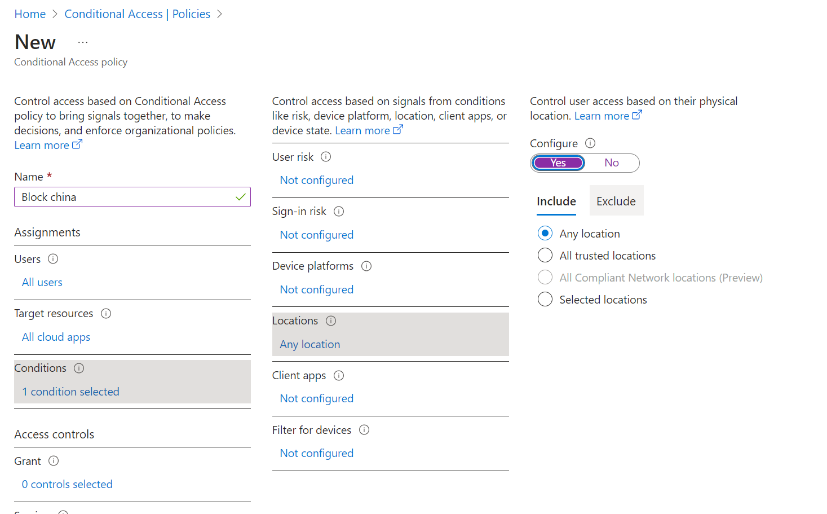

Slide 12
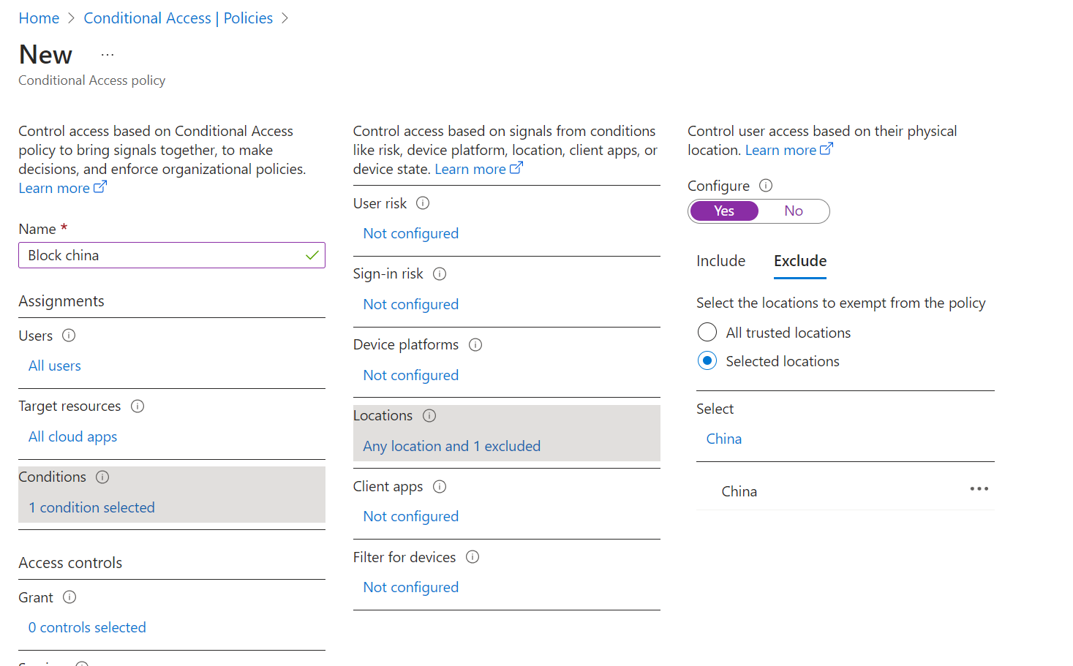

Slide 13
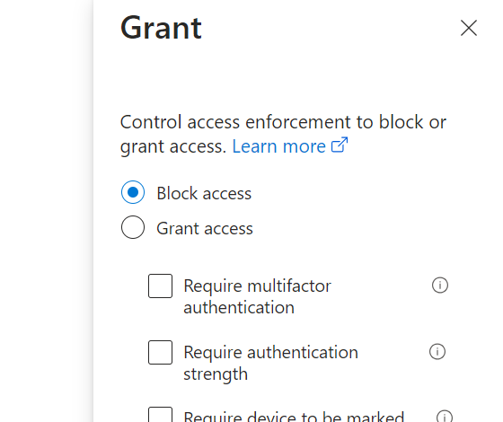

Slide 14
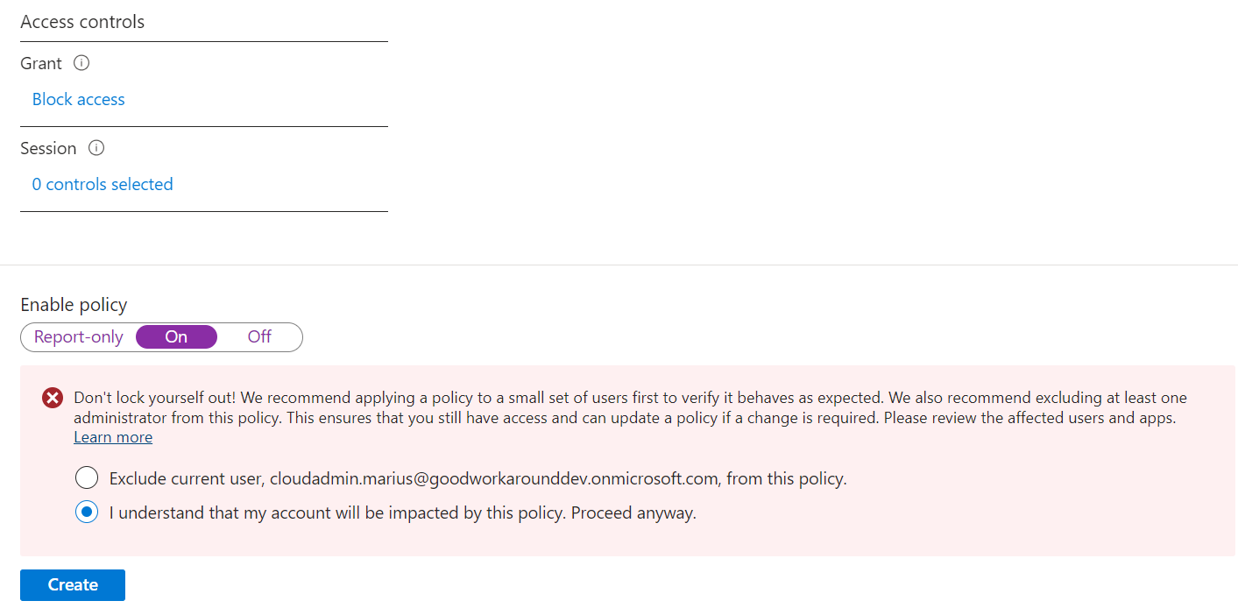

Slide 15
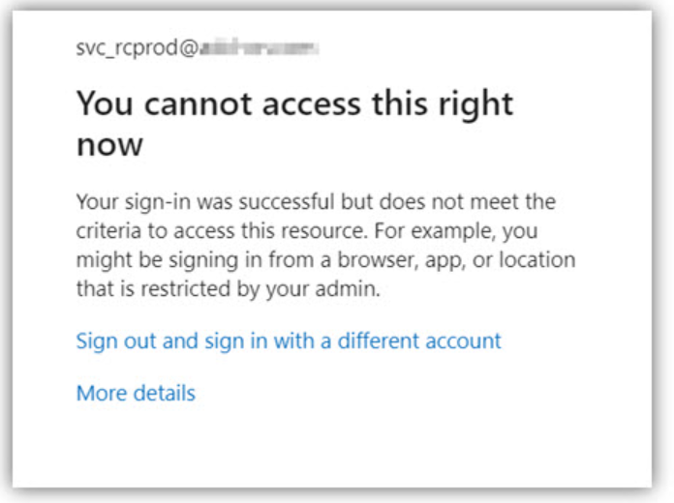

Slide 16

No problem!
Break glass!
Was not excluded from the policy
VPN to China
Identity Protection ruins your day!
Cloud Solution Provider delegated admin!
Nope, also blocked!

Slide 17

Microsoft support to the rescue!
Customer did not have premium support
Took three days to get resolved… no access to email, teams, files

Slide 18

What went wrong?
No break the glass user
But would it have helped?
Unclear responsibility
Red wine, late nights and conditional access is not a good mix

Slide 19
Other reasons to need one?
Last GA deleted (only possible in hybrid)
Risk increase for GA causing block
Lost GA account
Breach
Unable to meet device requirements for CA

Slide 20

The break glass account
Notes:
Greek gods – dog of hades, protects what is most important to protect

Slide 21

Best practices for break glass user accounts
Exempted from ALL Conditional Access Policies
Roll over password for each use, store safely
FIDO2 keys
Monitor activity and alert when used

Slide 22

One more thing
We blocked the break glass account!

Slide 24

Service Principal with Policy.ReadWrite.ConditionalAccess
Not blocked by CA targeting users
Only has access to modify CA
No secret to manage if you use managed identity
Logic App with url

Slide 25
Logic App

Slide 26

Backup topics
Authentication strengths
Protected actions
Apps regs and enterprise apps
Managed Service Identities

